Slide 1
CS 6349 - Network Security
Wireless LAN (802.11) Security

Slide 2
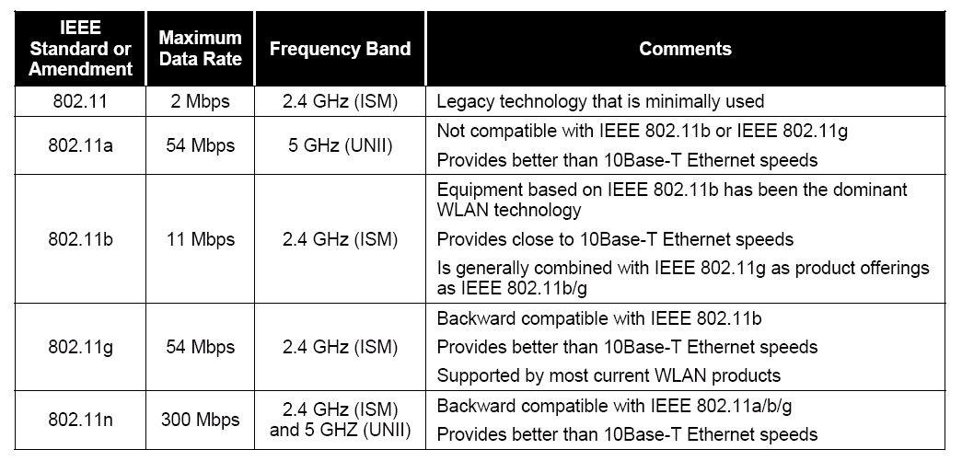
IEEE 802.11 WLAN Technologies
All support WEP - Wired Equivalent Privacy

Slide 3
Evolution of WLAN Security Technologies
WEP (1999)
  Security equivalent to (unencrypted) wired line link
    Not end-to-end… no security beyond the wireless link
WPA (2003)
  An intermediate solution for WEP’s security problems
  A subset of 802.11i technologies to boost WEP’s security w/o requiring hardware upgrades
802.11i (2004)
  Robust Security Network (RSN) concept
  Based on mature and proven security technologies
  WPA2 – 802.11i implementation by Wi-Fi Alliance

Slide 4
WEP
Designed to provide
  authentication, confidentiality, and integrity
  No support for
    Key management, authorization, replay protection, etc.

Slide 5

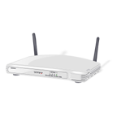
WEP Authentication
Client to AP authentication only
Two modes
  1. Open system – registers MAC address of mobile with the AP…. no crypto
  2. Shared key crypto based authentication
Response = KeyString XOR Challenge
KeyString = RC4(Shared Key)
Attack ?
Capture Challenge & Response
KeyString = Challenge XOR Response
Can answer future Challenges
Authentication Request
Challenge
Response
Confirm Success

Slide 6
WEP Confidentiality
RC4 with 24 bit IV and 40 bit WEP key
  24 bit IV – easily repeatable, sent as clear text
    Knowing few msgs w/ same IV helps in cryptoanalysis
  WEP’s implementation of RC4 is problematic
    9000+ weak IV values….. when used multiple times, can help discover WEP key by collecting modest number of messages
Wireless
Station
Access
Point
IV
Generation
Algorithm
IV sent as cleartext
within the packet
Shared
Key
Concat. of
IV and Key
Per
Packet
Key
RC4
Algr
RC4
Algr
Per
Packet
Key
Concat. of
IV and Key
Shared
Key
Payload
CRC
Generation
Algorithm
CRC
Payload
+
+
CRC
Payload
Plaintext input
Ciphertext
Plaintext o/p

Slide 7
WEP Integrity
Uses 32-bit CRC
  CRC is not cryptographically secure

Slide 8
WPA
A stopgap improvement over WEP
  Addresses two major WEP weaknesses:
    1. Design weakness with WEP
    2. Lack of effective key distribution method
Uses two components from 802.11i framework
  1. 802.1X – a generic 802 authentication protocol
    Helps with authentication and key management
  2. TKIP – Temporal Key Integrity Protocol
    Fixes problems w/ frame encryption and WEP integrity

Slide 9

802.1X Authentication
Authentication Server
(RADIUS)
802.11 Association
EAP Start
EAP ID Request
EAP Response ID
Authentication Request
Access Challenge
EAP Challenge Request
EAP Challenge Reply
Access Request
Access Success
EAP Success
WEP Key
Use for the WEP
session
User Data Transfer
EAP Protocol
RADIUS Protocol

Slide 10
EAP Methods/Alternatives
EAP-TLS
  Mutual authentication using public key certificates between user and authentication server (RADIUS)
  Establishes encrypted TLS session between the two
Protected EAP (PEAP)
  Two stages
  RADIUS server authenticates itself using certificates
  User can use some other method available in EAP
Lightweight EAP (LEAP)
  Cisco proprietary EAP
  Enables password based authentication for user

Slide 11
TKIP
16 bytes Temp Key
RC4 Key
Tx addr
Key mixing
48-bit IV counter
W
E
P
Cipher Text
MIC Key
||
Tx addr
MIC
Recv addr
Plain Text
Temp Key and MIC Key derived from the WEP key at the end of EAP authentication
WPA can be seen as a wrapper for WEP
RC4 Key is sender specific
Each message uses different RC4 Key
  48-bit IV as counter
MIC is cryptographic (does not use CRC)

Slide 12
802.11i
Provides options for stronger encryption
  WEP – for backward compatibility
  TKIP – short term solution to original WEP
    Only software/firmware upgrade needed on WEP devices
  CCPM – AES with Counter Mode and CBC_MAC
    AES requires new/upgraded hardware
802.1X based RSNA (Robust Security Network Assoc)
  A 4-way handshake to provide (mutual) authentication between mobile user and authentication server (e.g., RADIUS)
Key caching – for quick re-auth for roaming users
Pre-auth – share auth data among APs so that user does not need re-auth when moving to another AP

Slide 13
WLAN Security Threats
Threat classes
  Those involving radio link between wireless devices
    Intercept/inject messages
  Deployment of rogue wireless devices, i.e., APs
    Provides a backdoor to the network bypassing security measures, i.e., firewalls
  DoS attacks – flooding/jamming

Slide 14
Threats and vulnerabilities
Loss of confidentiality
  Due to radio nature, no/minimal security at PHY layer – anyone can hear anyone else
  Eavesdropping – sensitive/proprietary info, network IDs and passwords, configuration data, etc.
    Once recovering two ciphertexts sharing same IV, both data integrity and confidentiality can be compromised
    Once WEP key is recovered, can read any data over the WLAN
  Having an AP connected to a Ethernet hub also makes data on wired network vulnerable to eavesdropping
    Use of Ethernet switches alleviates these problems
  Malicious/irresponsible user may insert a rogue AP into the network with no/minimal security configuration

Slide 15
Threats and vulnerabilities
Loss of integrity
  Can be compromised by deleting/modifying data in an e-mail sent over a WLAN
  Legacy 802.11 standards provide no strong integrity
Loss of availability
  Jamming or flooding
  Can use bogus management frames to disassociate a client from an AP
  Can flood bogus association frames to fill up association table at AP
  Downloading large files to monopolize bandwidth resources on WLAN

Slide 16
WLAN security countermeasures
Due to inherent vulnerabilities of legacy WLAN standards, difficult to achieve
Involves
  management,
  operational and
  technical countermeasures

Slide 17
WLAN security countermeasures
Management countermeasures
  Having a wireless network security policy in place
    Which users/groups are authorized to use WLANs
    Who is responsible for installing/configuring APs
  WLAN infrastructure security
    Physical security of WLAN devices
    Type of info that can be sent or not over WLANs
    WLAN transmission protection policy – req’s for use of encryption and crypto key management
  WLAN client device security
    When and where clients are allowed to use WLANs
    Standard hw/sw configs
    Guidelines for reporting loss of WLAN client devices
  WLAN security assessment
    Frequency and scope of WLAN assessment
    Actions to be taken to address rogue/misconfigured devices

Slide 18
WLAN security countermeasures
Operational countermeasures
  Physical security of WLAN devices
    Personnel identification
    External boundary protection
  RF range for each AP in a legacy 802.11 WLAN
    Range has to be limited to protected physical boundary of the organization’s facilities
    Use of site survey tools to measure range of AP devices
    Helps protection against easy eavesdropping

Slide 19
WLAN security countermeasures
Technical countermeasures
  Use of hw/sw solutions to help secure WLAN
Confidentiality and Integrity Protection
  WPA2-PSK (AES) – 802.11i based secure WLAN standard
  Use of VPNs – to protect sensitive communications
    Between WLAN clients and a VPN end point beyond AP
  Hybrid solution – use of WLAN security soln and VPNs
Wireless IDS and IPS
  Can help determine unauthorized access to the WLAN
  Can help detect misconfigured WLAN clients, rogue APs, ad hoc nws, and other possible violations of WLAN policy

Slide 20
WLAN security countermeasures
AP Configuration
  Should be done acc. to established security policy
  Thick AP – handles encryption and overall management of client devices connected to it
  Thin AP – processing of encryption and policy setting occurs in a centralized switch/controller
  A thin AP is generally more secure than a thick one
  Issues with AP management and WLAN configurations

Slide 21
WLAN security countermeasures
AP management
  Configuring administrator access – do not use default password and default settings that come with the box
  Controlling reset function – some devices have hw reset button which does not require any privileges to use
  Use of SNMPv3 – instead of SNMPv1 or v2
  Use of HTTP – has to be protected using SSL (HTTPS)
  Enabling logging – helps ensure user accountability and records malicious activity

Slide 22
WLAN security countermeasures
WLAN configuration
  Changing default channel and power output – to limit RF to protected boundary and minimize interference
  Changing SSID – change from factory default to help prevent users from accidentally connecting to the wrong WLAN
  Avoiding pre-shared keys (PSK) –
  PSK = network name + SSID + passphrase
  keys derived from passphrase shorter than 20 chars are weak
  Using MAC ACL functionality
  (Do not) Use of DHCP – DHCP can assign an IP address to all including intruders – use static IP addresses instead
  Maximize beacon interval – make it difficult to learn config. parameters for an intruder

Slide 23
WLAN security countermeasures
Client device security
  Automatic connection – disable to avoid connecting to a malicious WLAN
  Personal firewall – helps with unwanted connections from remote systems
  Host-based IDS/IPS – monitors internal state of the client device and logs activities
  Antivirus – helps assist spread of viruses, worms
  Ad hoc mode – disable to avoid inadvertent or malicious connections to the client device
  IEEE 802.11 radio mgmt – disable RF if not needed
  Policy enforcement – client config should comply with security policy

